Slide 1
PhysioNet Challenge – AF classification
Speaker: Yu-Cheng, Lin
Advisor:
Date: 2019/10/20

Slide 2
Outline
About this paper
Result
Problem

Slide 3
About this paper
Title: Towards Understanding ECG Rhythm Classification Using Convolutional Neural Networks and Attention Mappings
Author: Sebastian D. Goodfellow et. al
From: Proceedings of Machine Learning Research 85:1-18, 2018

Slide 4
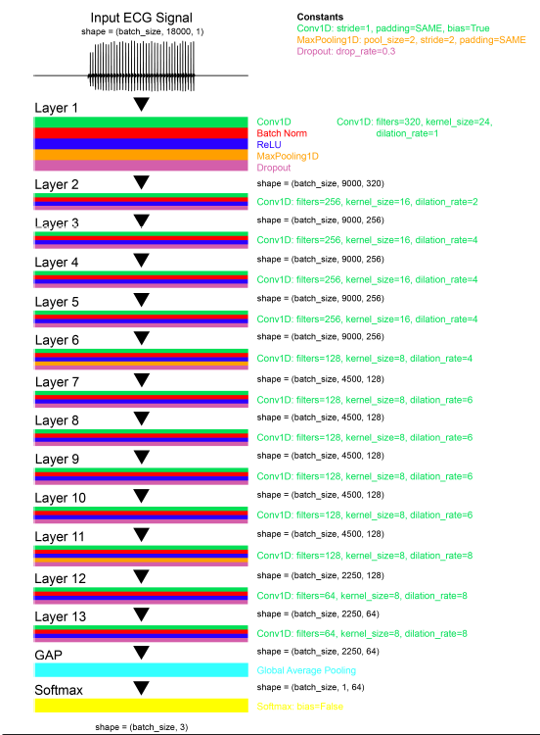
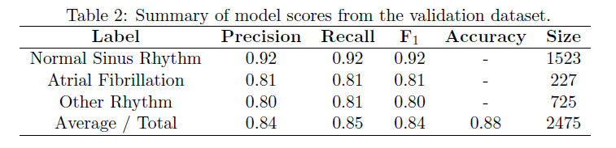
Model
Learning rate: 1e-3
Train validation split: 0.3
Weighted CE loss
100 epoch, batch size 10

Slide 5
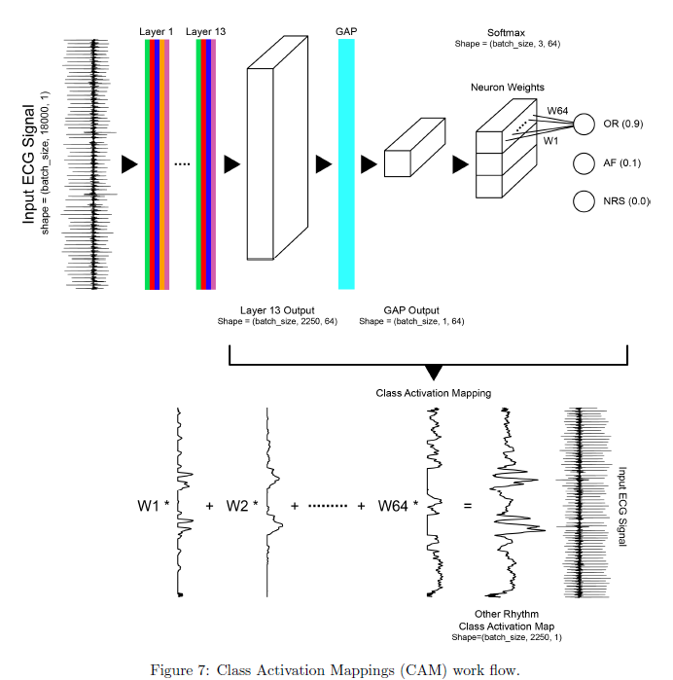
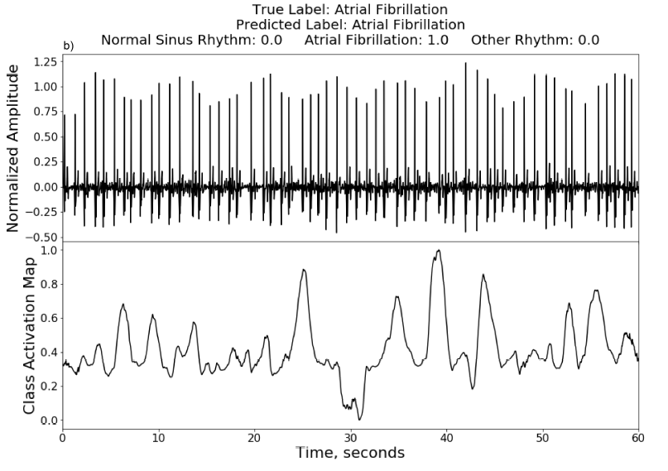
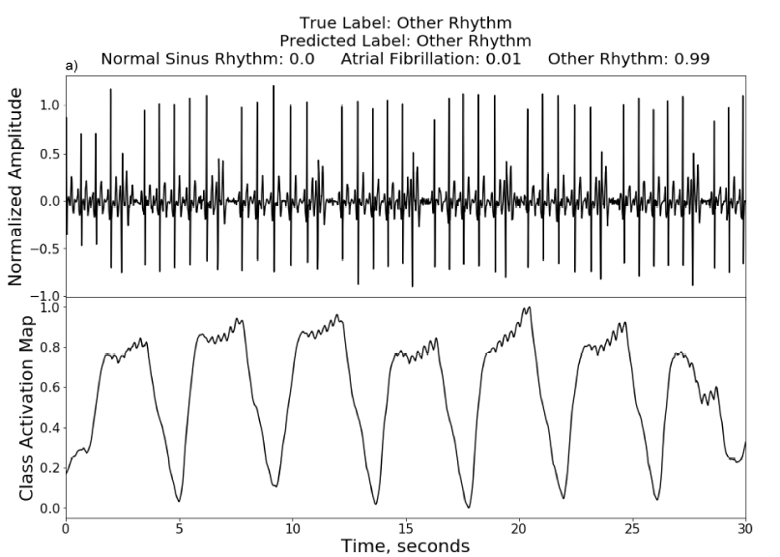
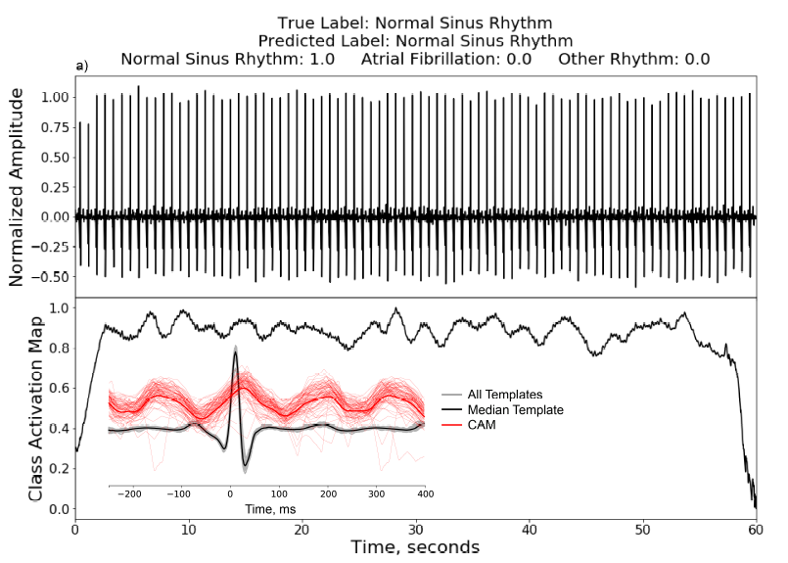

Slide 6
Result
Model idx | L-rate | loss | filter | normalize | Result
2,3 | 5*1e-4 | Ce |  | F | 0.64@66
4 | 5*1e-4 | Ce | 3-45,ord-5 | F | 0.61@10(S)
5 | 1e-5 | Ce | 3-45,ord-5 | F | 0.61@4(S)
6 | 5*1e-4 | Ce | 3-45,ord-32 | F | 0.61@57(S)
7 | 5*1e-4 | Ce | 3-100,ord-32 | F | 0.61@9(S)
8 | 5*1e-4 | Ce |  | F | 0.65@61
9 | 5*1e-4 | Ce | 3-45,ord-1 | MR | 0.29@22(X)
10 | 1e-5 | Ce |  | MR | 0.70@120
11 | 1e-5 | Ce | 3-45,ord-1 | MR(first) | 0.33@16(X)
Ce: categorical crossentropy
3-45: bandpass 3-45 Hz
Ord-i: filter order i
F: random flipping aug.
MR: median R-peak normalize
MR(first): normalize then filtering
(S): valid acc stuck
(X): fatal error
Valid_acc@epoch

Slide 7
Problem
Normalize Median R-peaks improve acc.
There is some problem in filtering

Slide 8
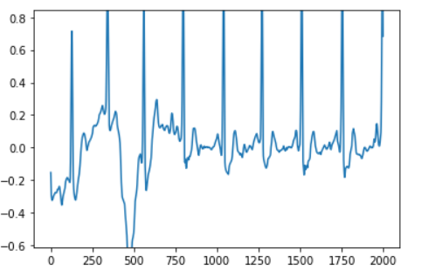
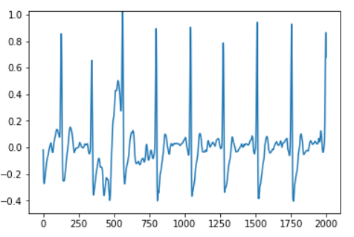
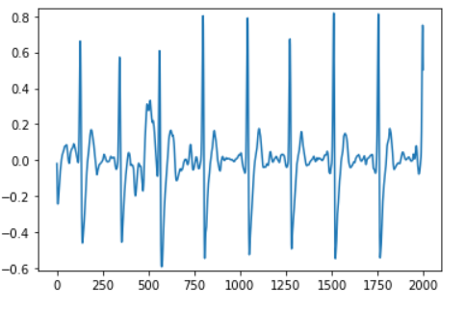
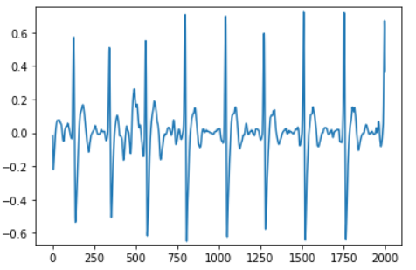
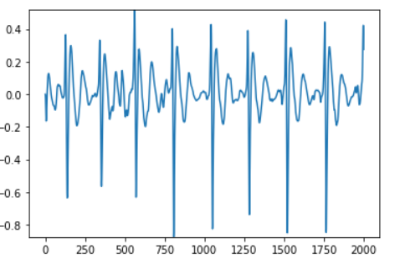
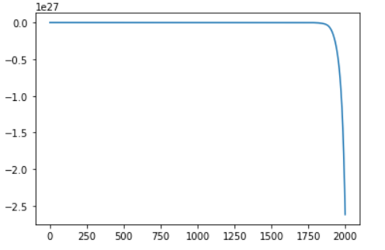
original
1-45,2
2-45,2
3-45,2
3-45,5
3-45,10
x-y,z – BP x-y Hz with z order

Slide 9
資料長度砍半?(大部分10000)
Lead reversal problem: train both x and –x
Preprocessing – remove noisy & unusual signal: normalization?

